Slide 1
《英语国家社会与文化入门》(下册）
The Society and Culture
of Major English-Speaking Countries
An Introduction
(Book Two)

Slide 2
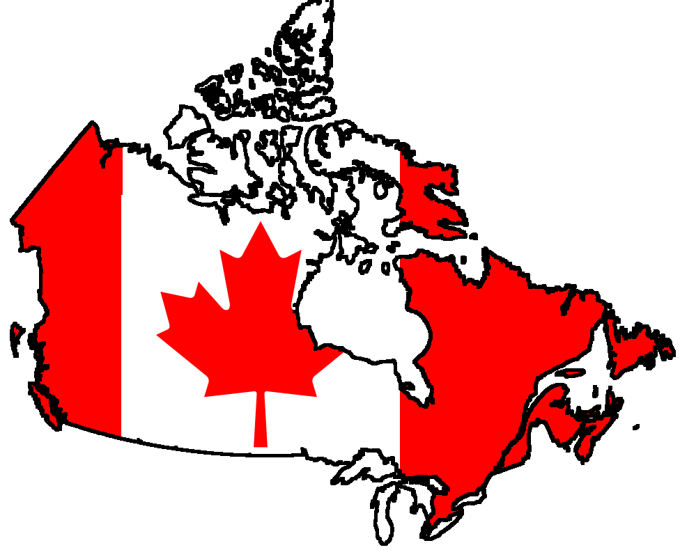
Canada Unit 19 The Canadian Mosaic
Welcome to Canada Bienvenue au Canada

Slide 3
Quiz
Give the English and a brief explanation for the following:
1 马赛克文化
2 多元文化主义
3 第一民族/原住民
4 梅蒂斯人
5 法裔加拿大人

Slide 4
Focal Points
the Canadian mosaic
multiculturalism
the First Nations
the Inuit
the Metis
immigration policy of Canada
Immigration Act 1976
Quebec and French Canadians

Slide 5
This Unit Is Divided into Four Sections
The First Canadians
The Settlers
French Canadians
The Story of a Canadian

Slide 6
Overview
American “melting pot” -- immigrants coming to the new
country of the US and throwing off their old
customs, languages and traditions in favour of
becoming “American”
Canadian “mosaic” -- immigrants do not throw off their
customs and ways of life but adapted them to the new
environment, thus resembles a mosaic of different
cultures which overlap but do not overwhelm each other

Slide 7
Multiculturalism
Origin: the debate on bilingualism and biculturalism in the 1960s; a Royal Commission examined relations between French and English Canada; other ethnic communities demanded that their heritages also be acknowledged.
Definition: “a multicultural society within a bilingual framework”; government provided money to help different ethnic groups retain their identities.

Slide 8
Multiculturalism VS Canadian “national identity”?
-- this patchwork quilt of different nationalities and communities is central to Canada’s national identity

Slide 9
I. The First Nations
What about the names?
1. The old name of “Indians” – mistakenly called by Columbus, now discarded
2. “The First Nations” –
first – original inhabitants
nations – many nations/tribes that have different languages,
customs and beliefs
* “The First Nations” does not include non-Indian peoples such as the Inuit or the Métis.

Slide 10
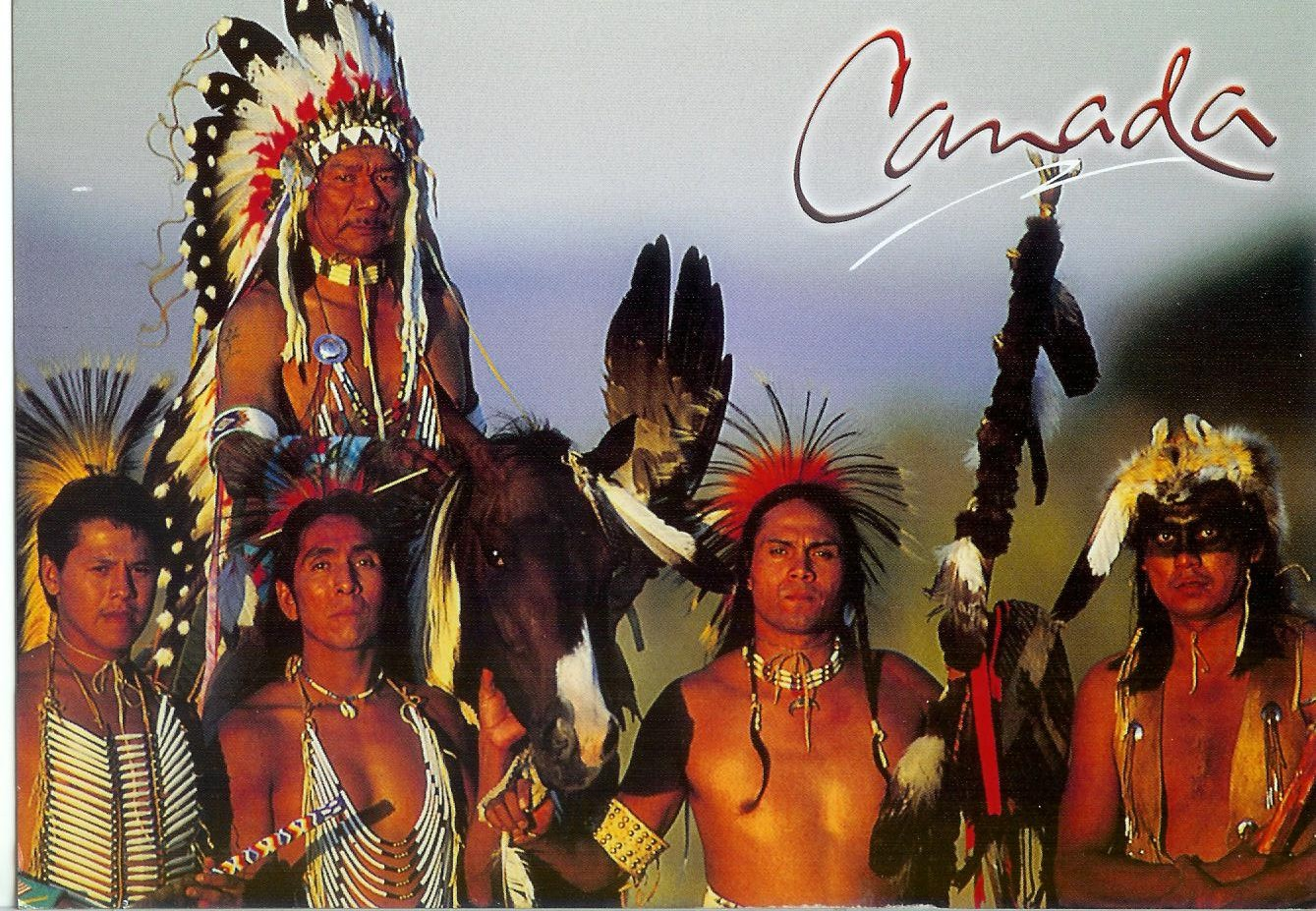
Population
The First Nations now make up about 3.8% of the Canadian population, and their numbers are increasing due to high birthrates.

Slide 11
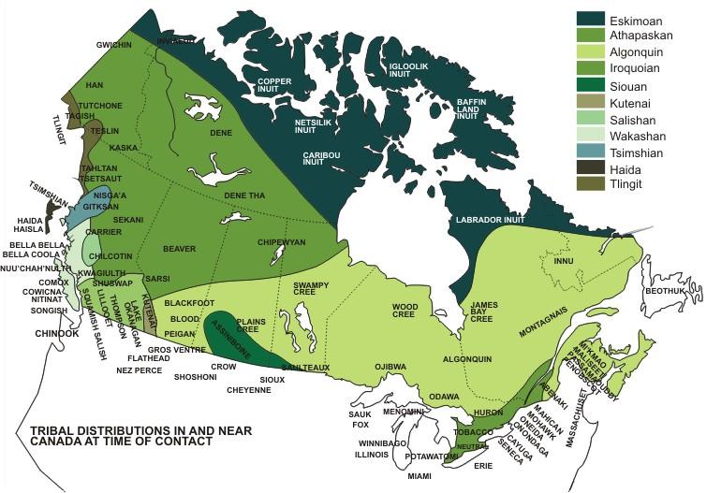
The languages, beliefs, customs and activities of the First Nations varied according to where they lived.
Coastal tribes – fishing and hunting
Prairie tribes – nomads hunting buffalo
central and eastern tribes – growing crops and hunting
Tribal distributions at time of contact

Slide 12
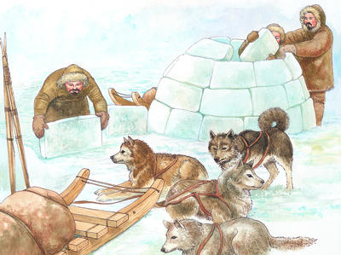
Two other aboriginal groups
1. The Inuit – in the arctic area, hunting, carving and making handicrafts
2. The Metis – descendants of French fur traders and Indian women; involved in the fur trade
Inuits building an igloo

Slide 13
Past discriminations
were coerced into signing treaties which allowed settlers to take over their land, and had been treated as second class Canadians for centuries
were forced to live on reserves
until 1961, were forbidden to vote or consume alcohol

Slide 14
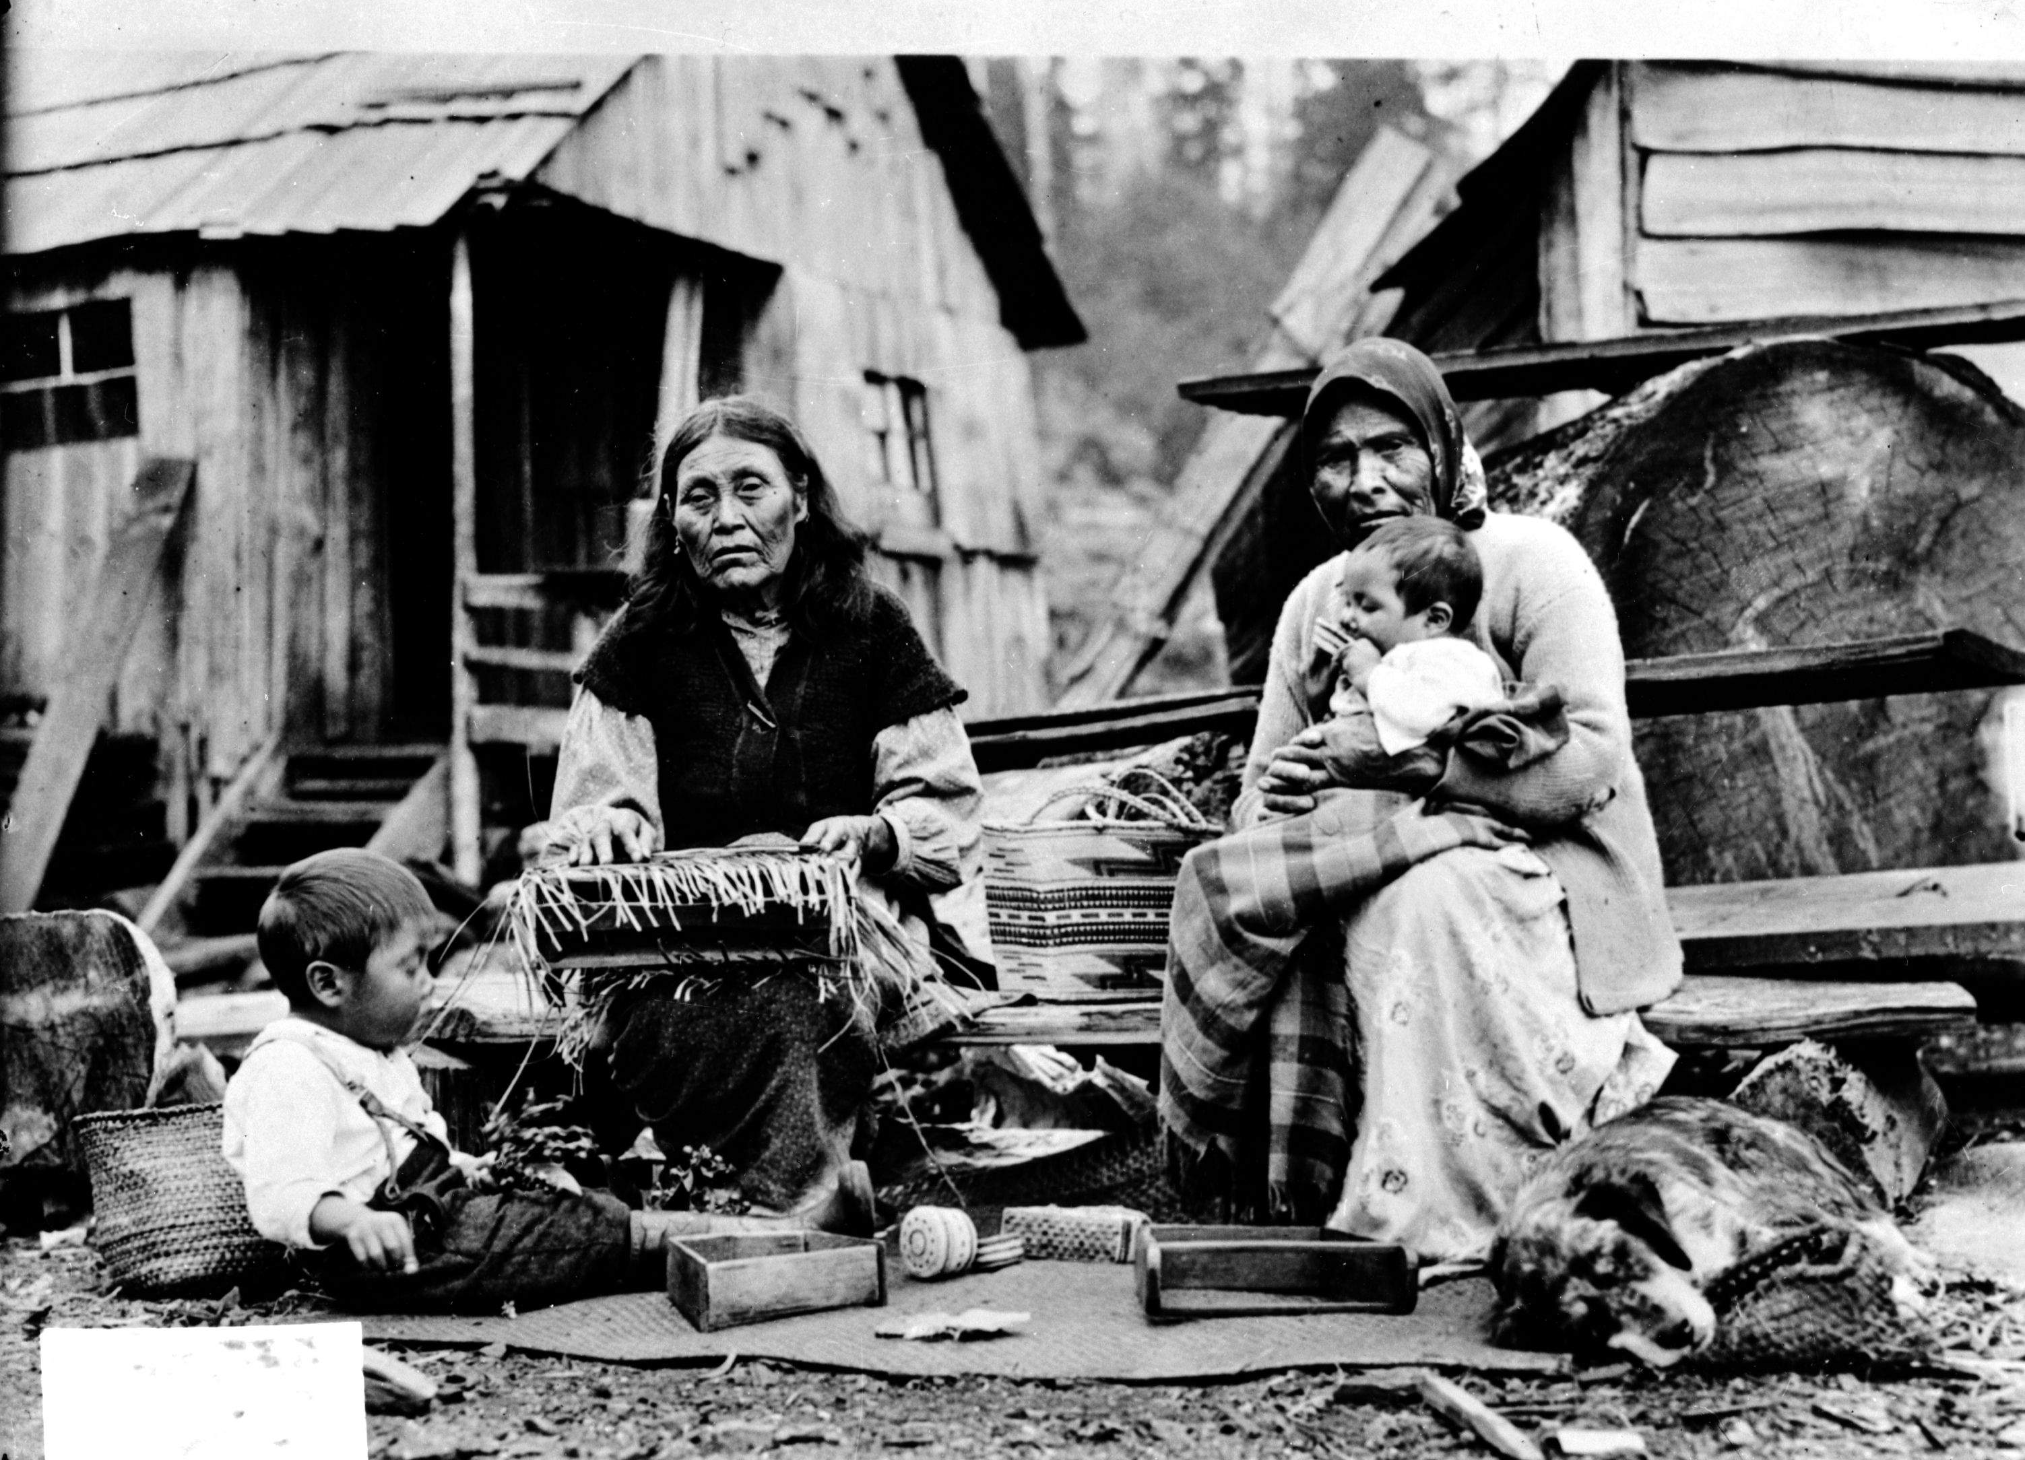
Present problems
Canada’s poorest group of people -- income is less than half the Canadian average
life expectancy is 10 years lower than the Canadian average
infant mortality rate twice as high; vulnerable to diseases like tuberculosis
suicide rate is the highest in the world

Slide 15
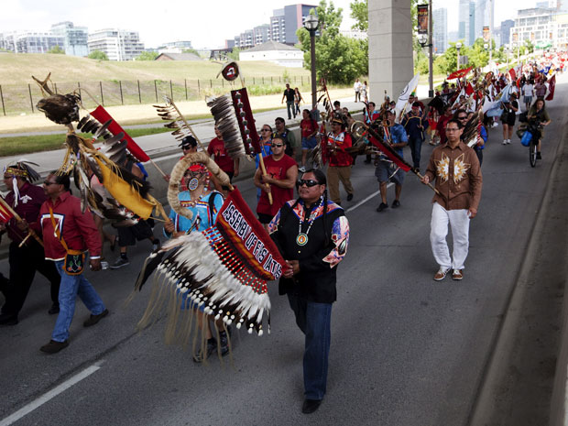
Recent progress
more politically active
e.g. engaged in negotiating land claims with federal and
provincial governments to have more control over their
economic, social and political futures.
The First Nations people took to the street
for land claims

Slide 16
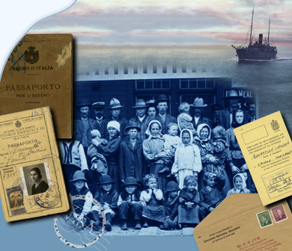
II. The Settlers
Canada’s immigration policies have largely been determined by economic considerations and have followed the demands of the changing Canadian labour market.

Slide 17
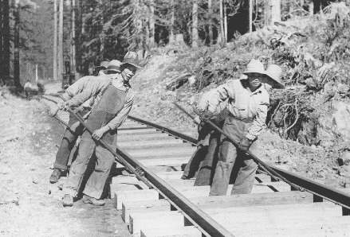
The 1890s - the 1920s
The government encouraged farmers and miners from central and eastern Europe to settle the prairie provinces and develop the mining industry; and brought in Chinese labourers to help build the railroad.
Chinese labourers working at the
Pacific Railway

Slide 18
The Great Depression of the 1930s
Canada’s immigration market was closed to virtually everyone but
Britons and Americans.
After the WWII
Canada opened its immigration door again but restrictions on Asians persisted and immigrants from Europe were given favorable policies.
Largely due to immigration, the Canadian population increased from 13 million to 27 million between 1947 and 1991.

Slide 19
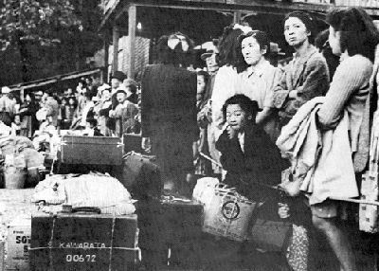
Immigration policy is directed by both provincial and federal governments, and at time this has led to particular tensions
-- the case of Japanese Canadians in the WWII
Japanese Canadians were moved to
interment camps east of the Rocky
Mountains

Slide 20
In more recent years, the federal government has encouraged Asian immigration, created a new category of “entrepreneurial immigrants” and investor immigrants.
Negative effects – the case of Vancouver
-- drove up property prices, causing some resentment among established residents.
-- Cantonese or Mandarin Chinese are spoken rather than English

Slide 21
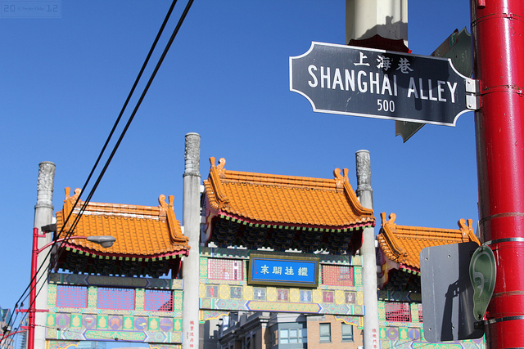
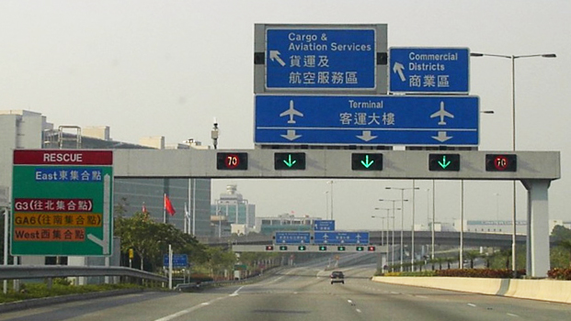
Vancouver Chinatown
Bilingual street signs in Vancouver
One of the rich residential areas

Slide 22
Trends of immigration policy
Continue to encourage immigration
-- Canada has an aging population and a falling birthrate. It needs to encourage immigration to ensure a strong work force and the tax base.
Less racist than it used to be
-- Larger numbers of visible minorities immigrated to Canada.

Slide 23
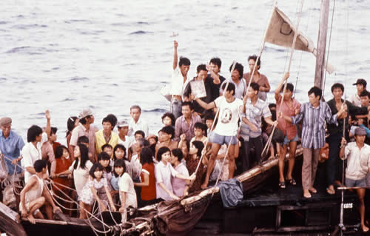
“Boat People”
By the end of 1980, Canada had the highest per capita intake of Vietnamese refugees in the world, topping 60 000 Vietnamese, Cambodians, and Laotians.

Slide 24
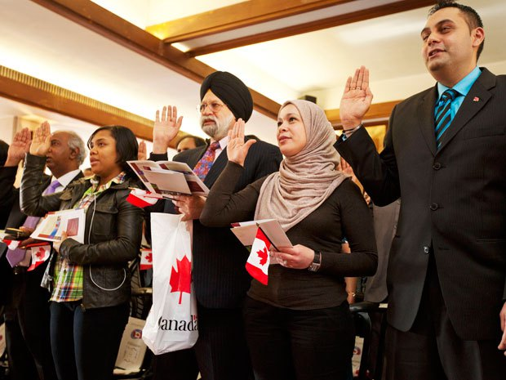
The increase of visible minorities
In recent years, the top four source countries of immigration to Canada were China, India, the Philippines and Pakistan.
A citizenship ceremony in
Toronto

Slide 25
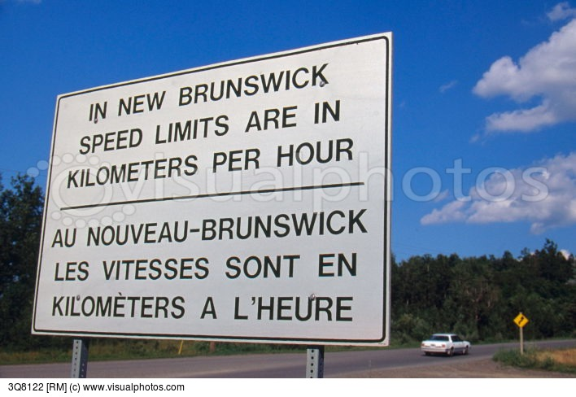
III. French Canadians
French Canadians in Quebec
French Canadians outside Quebec
Bilingual signs in New
Brunswick

Slide 26
French Canadians in Quebec
French settlers established communities in the 1600s.
About 81.4% of the population claim French as their mother tongue, but about 95% of Quebecers can speak French.
Their linguistic and cultural heritage is threatened by the dominance of English Canada.
Quebec City

Slide 27
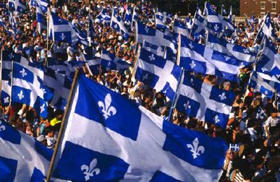
“Distinct Society”
Quebecois have been fighting for the independence of Quebec.
They want to protect Quebec’s “distinct society”.

Slide 28
French Canadians Outside Quebec
About one million French speakers live outside Quebec.
They mainly are in provinces like Manitoba, Nova Scotia, and New Brunswick.
The federal government offers programs and services to protect their language and culture.

Slide 29
IV. The Story of a Canadian
Being a Canadian often means being a mix of different cultures and heritages.
Even though Canada as a country is still very young, being a Canadian means having a lot of history.
The Mennonites are members of a Protestant religious group that was formed during the Reformation in Europe. The Mennonites spread all over Europe to escape religious persecution.

Slide 30
Questions for Discussion
How do you understand “multiculturalism” in Canada?
What is the advantage of living in a multicultural society? Do you think multiculturalism is also a characteristic of China?
Please comment on Canada’s practical economic approach to immigration. Is it natural that people tend to accept more readily those who fit more easily into their society?
Why is immigration an explosive political issue in Canada?

Slide 31
The End
高等教育出版社
2015

